Slide 1





PROJET « ATN-WD »
V0 – INSTALLATION & GUIDE D’UTILISATION
08/04/2024

Slide 2
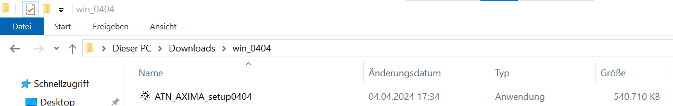
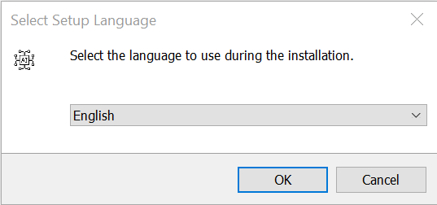
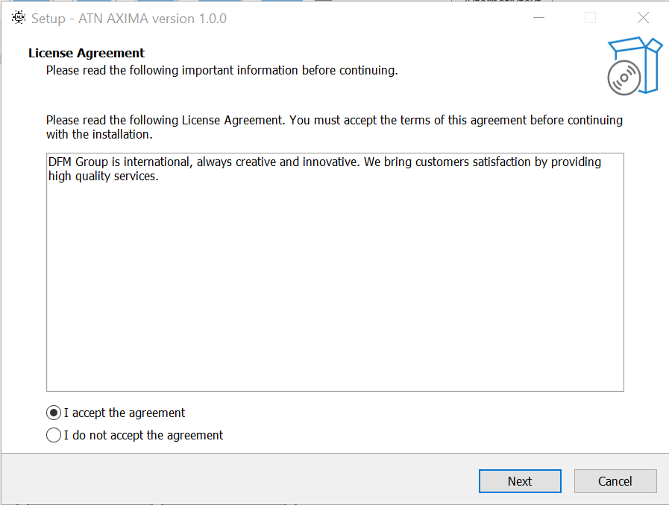
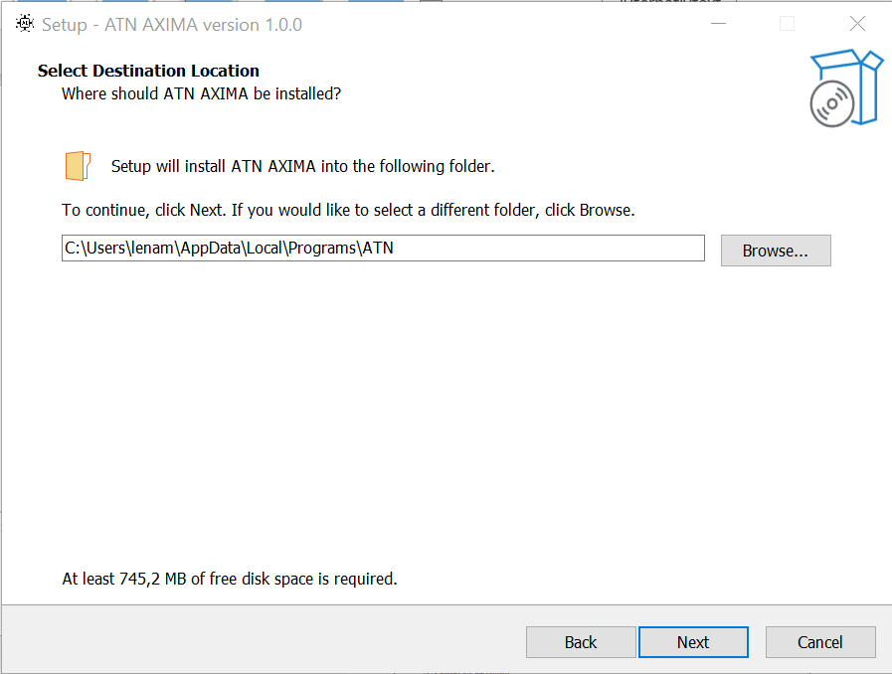
1. INSTALLATION
1
2
4
3
2
08/04/2024

Slide 3
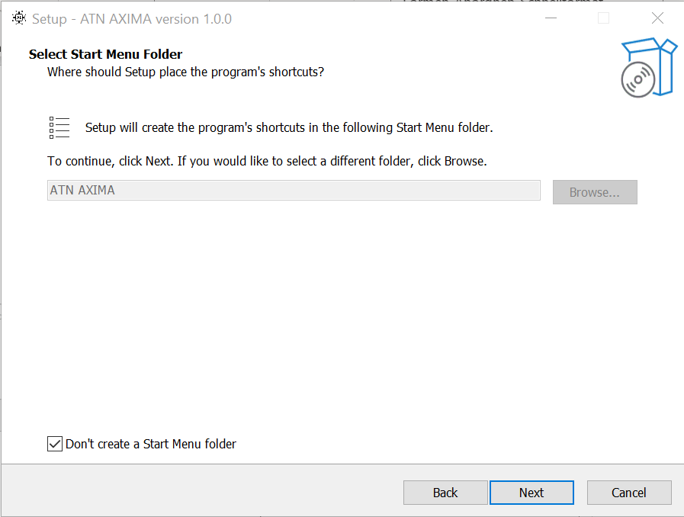
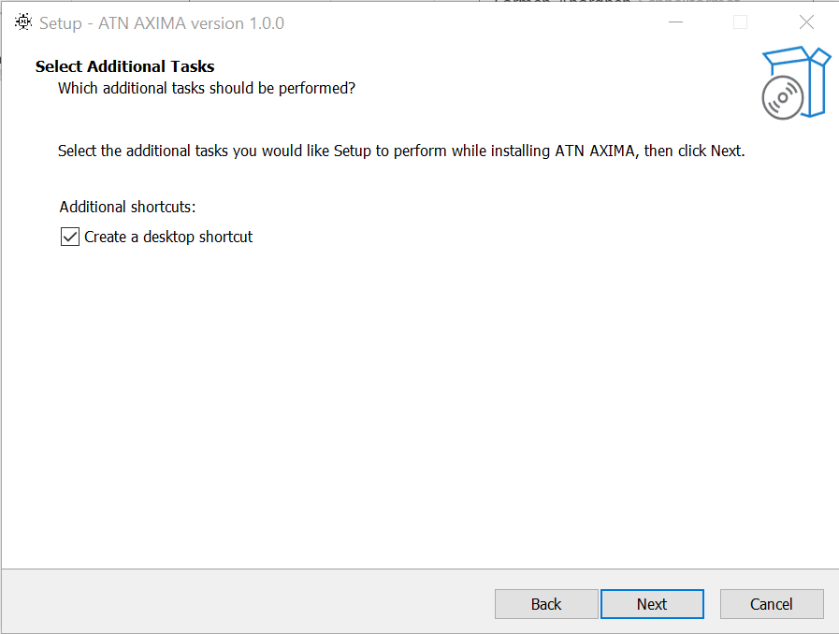
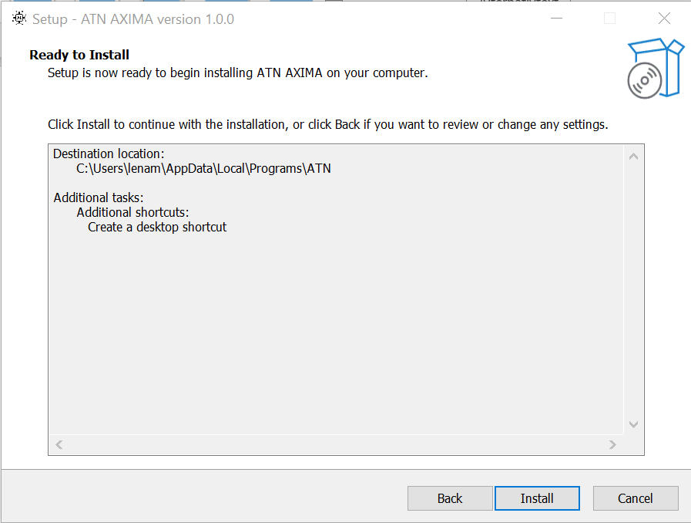
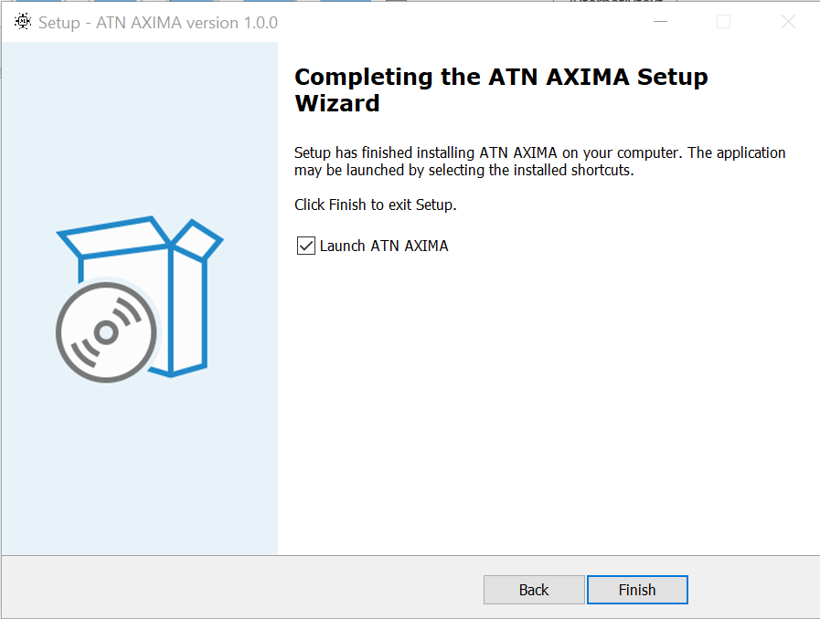
1. INSTALLATION
6
5
8
7
3
08/04/2024

Slide 4
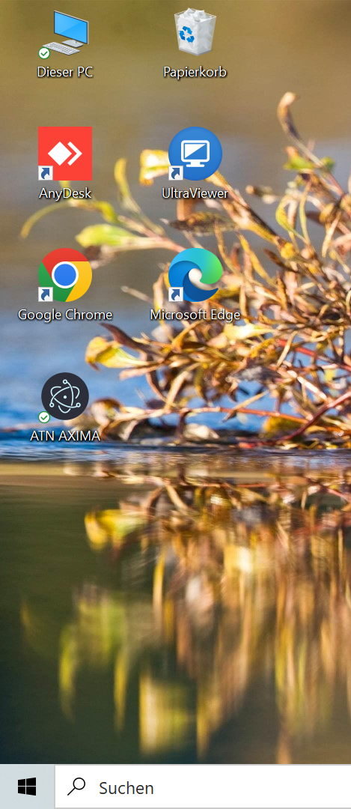
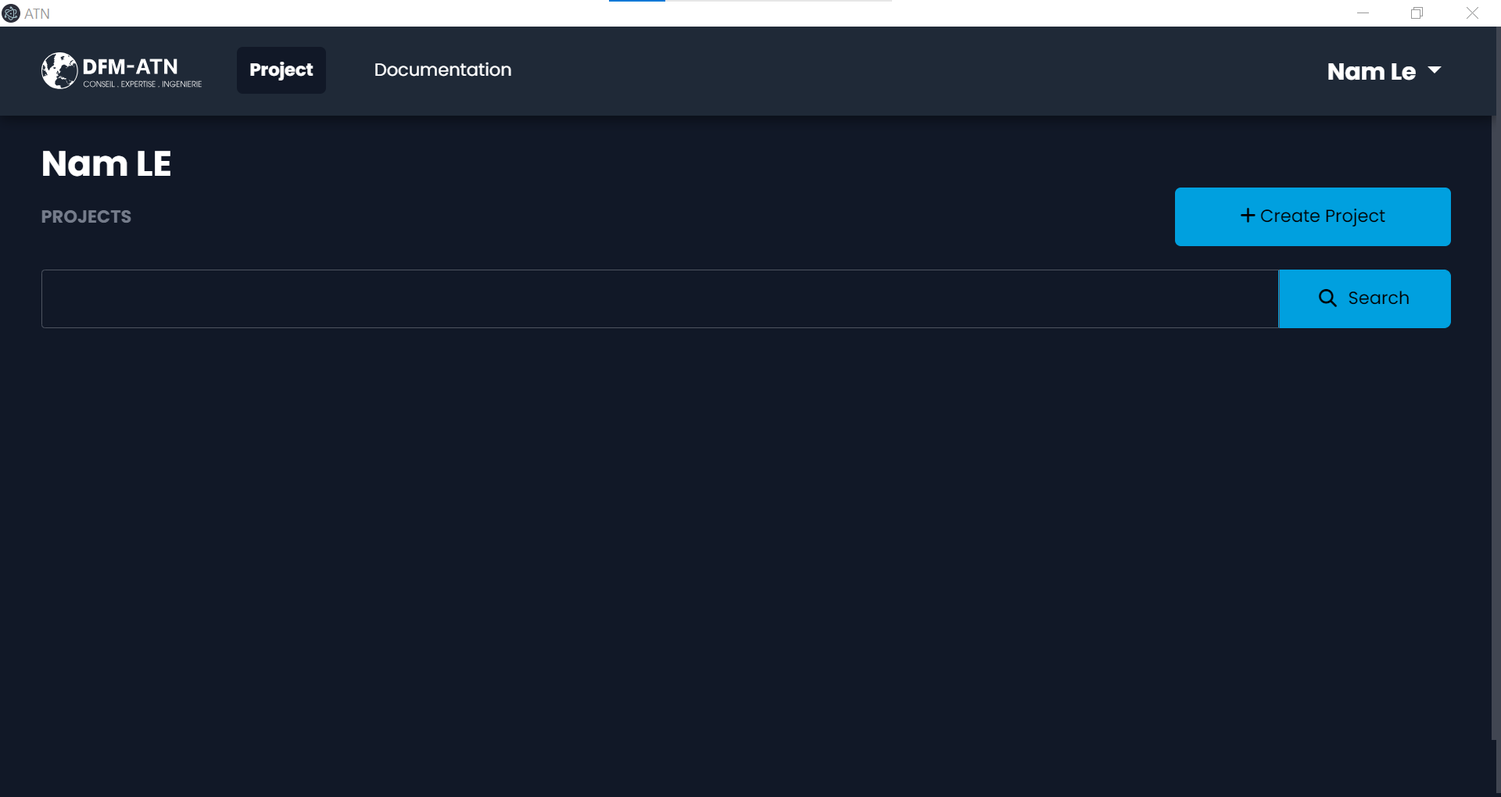
2. GUIDE D’UTILISATION
2
1
1. Click on the ATN-AXIMA icon on desktop.
2. On the homepage, click on “Create Project“ to create a new project.
4
08/04/2024

Slide 5
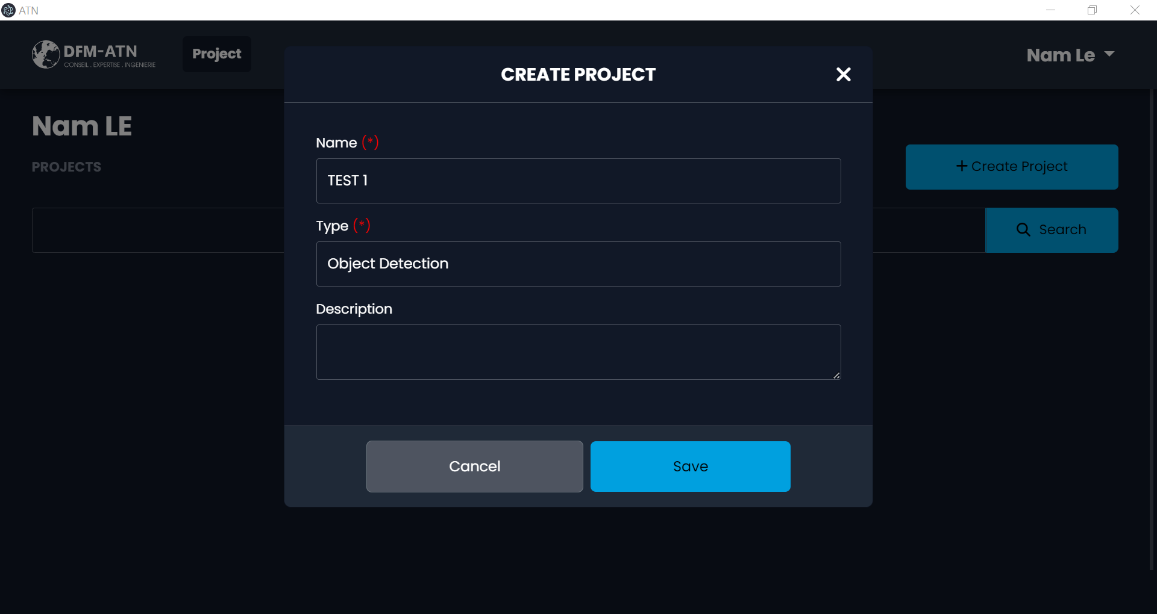
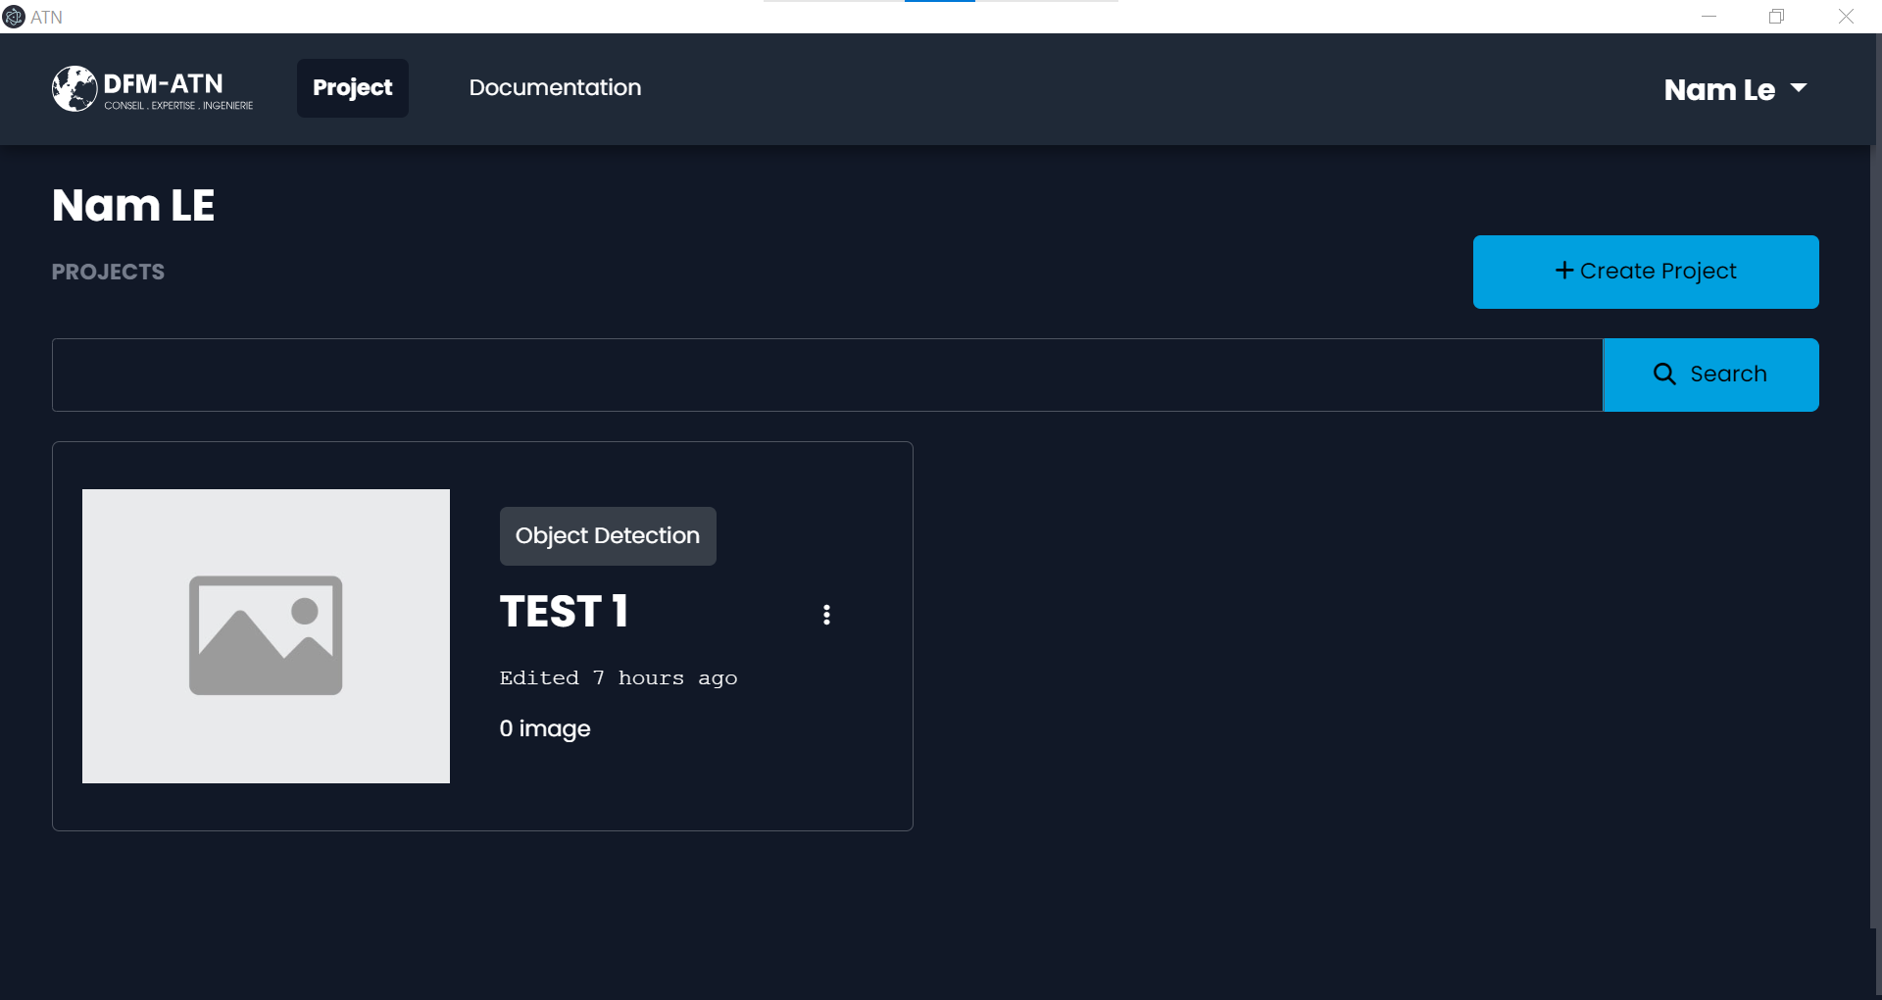
2. GUIDE D’UTILISATION
4
3
3. Enter the name (TEST 1) and the type (Object Detection) of this project, and then click on “Save“ button.
4. Click on the image to open the workspace of this project.
5
08/04/2024

Slide 6
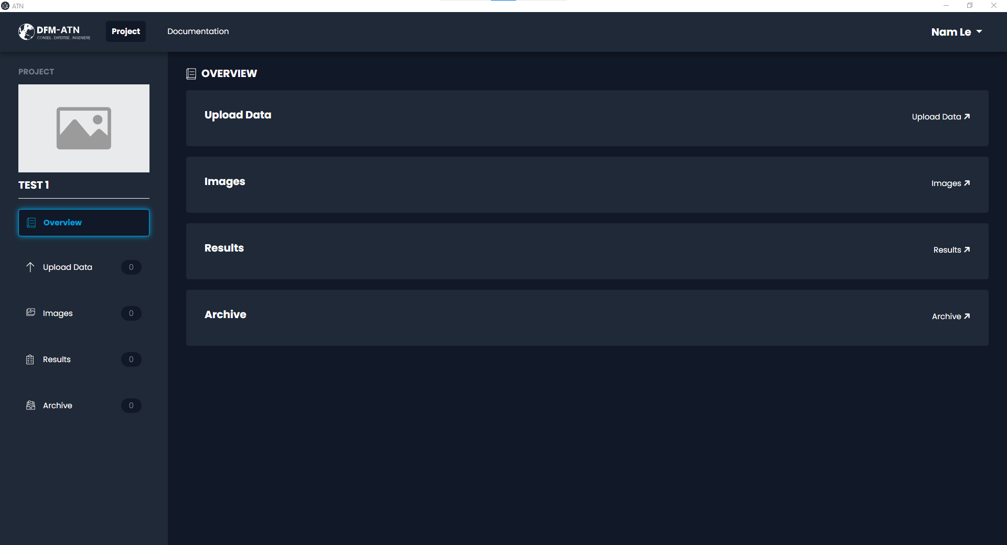
2. GUIDE D’UTILISATION
5
5. Click on the “Upload Data“ tab to upload plans from pdf files.
6
08/04/2024

Slide 7
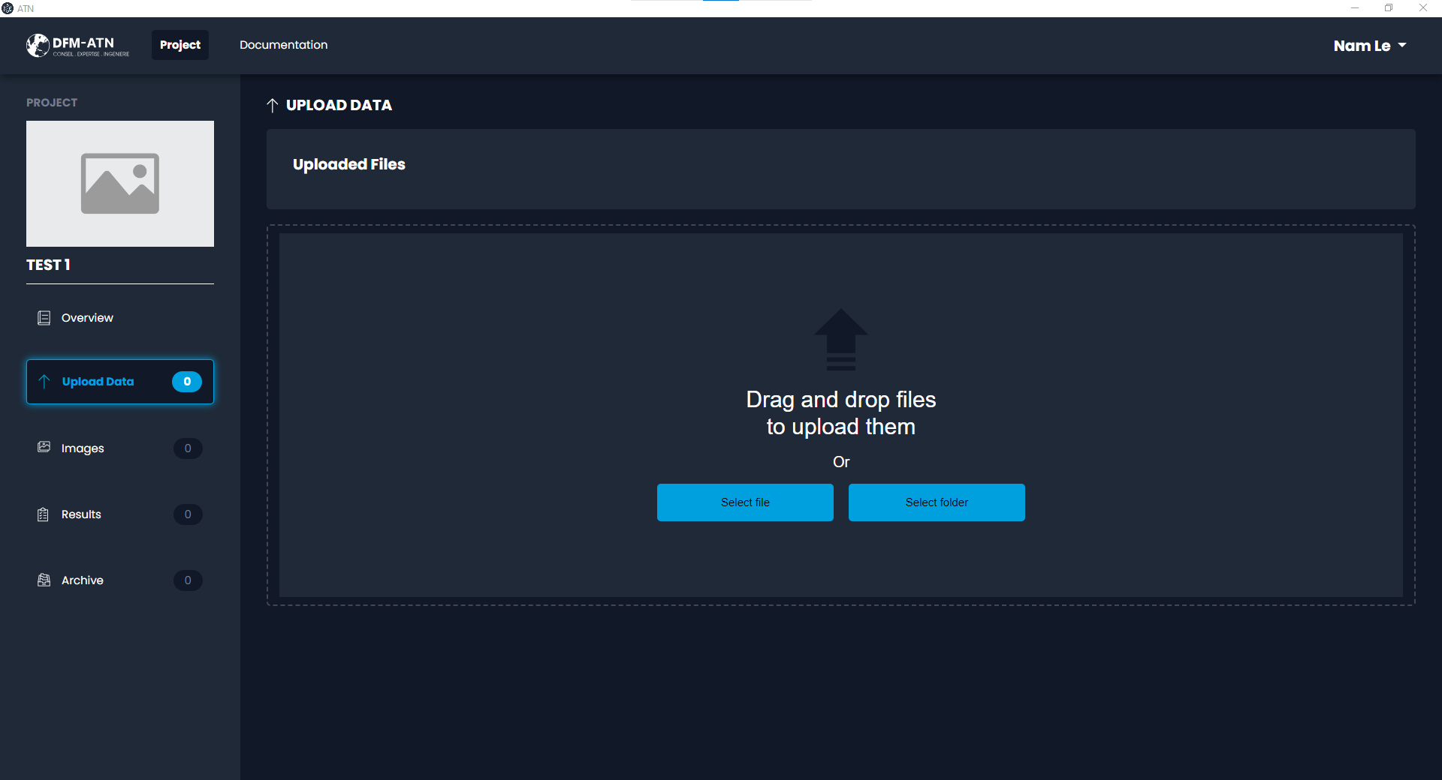
2. GUIDE D’UTILISATION
6
6. Click on the “Select file“ button to select a pdf file.
7
08/04/2024

Slide 8
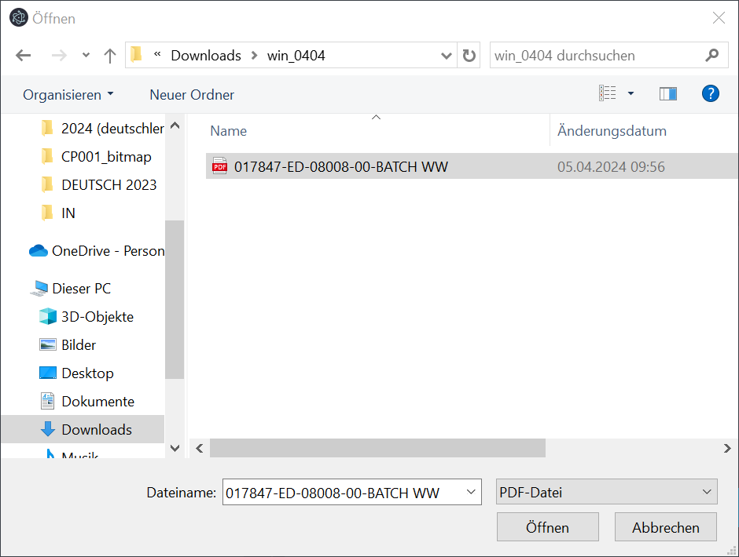
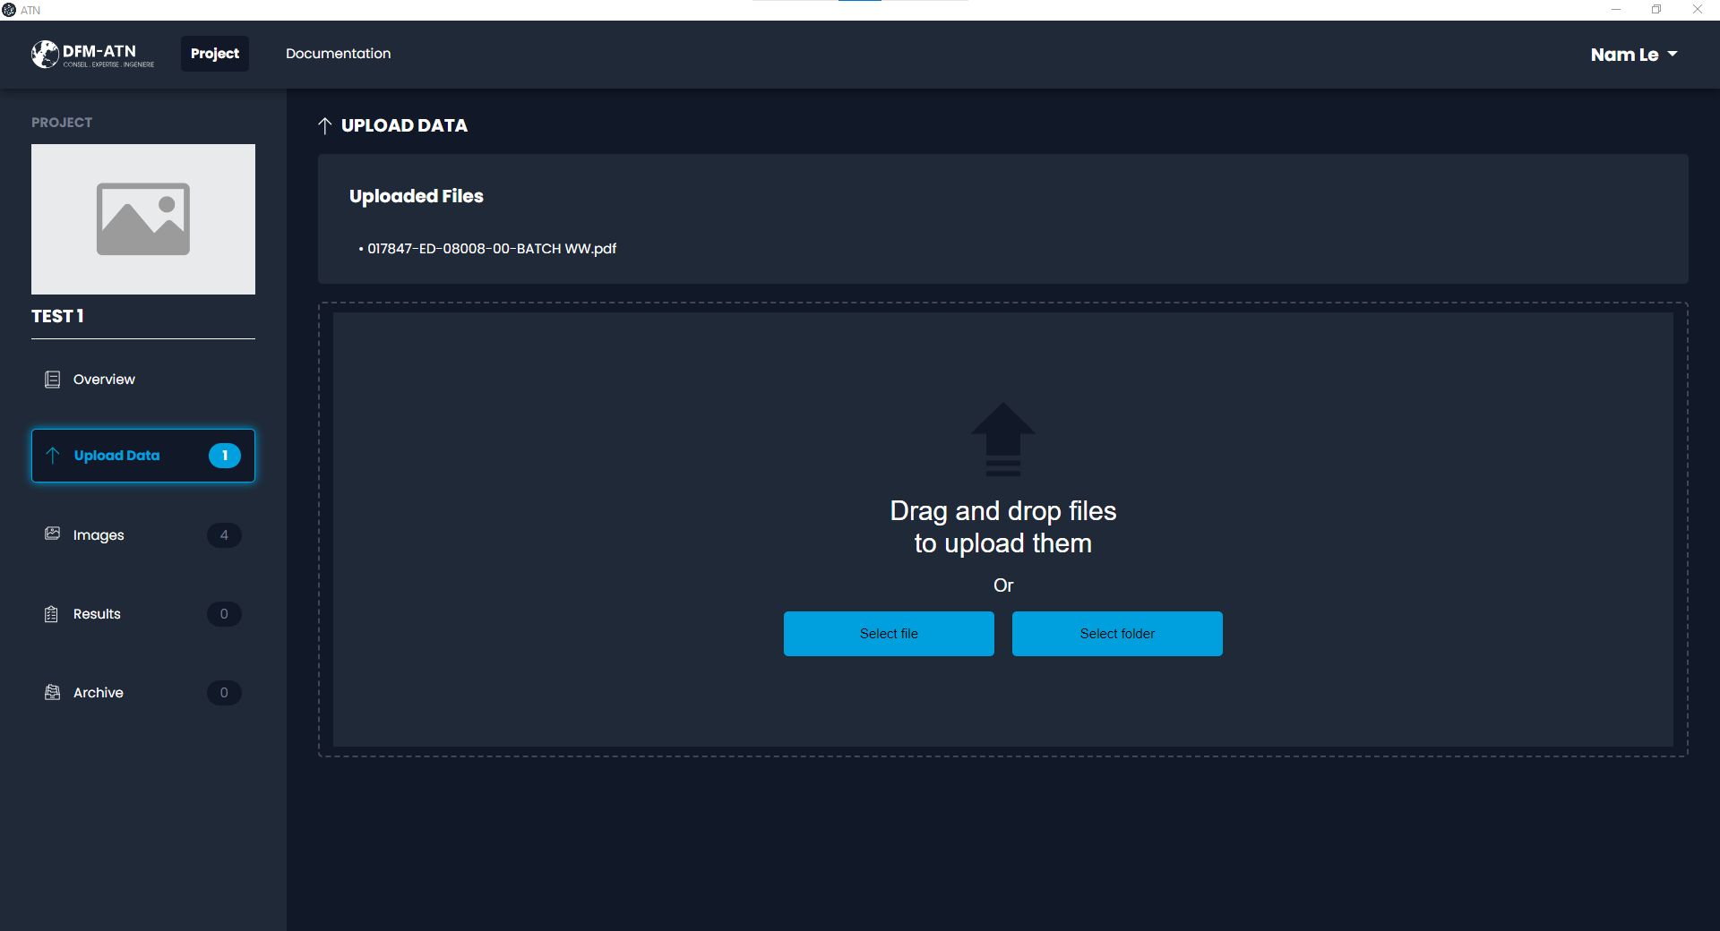
2. GUIDE D’UTILISATION
7
8
7. Select a pdf file.
8. Wait a few seconds, the file name will appear on the list.
8
08/04/2024

Slide 9
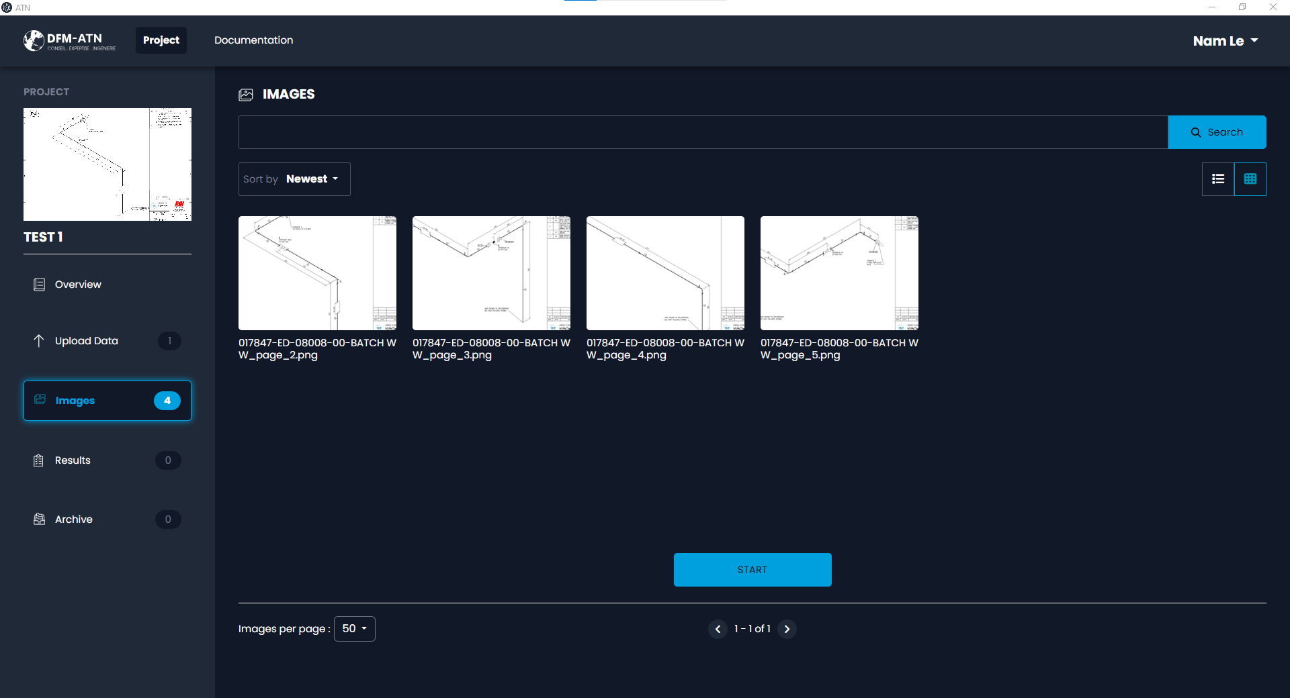
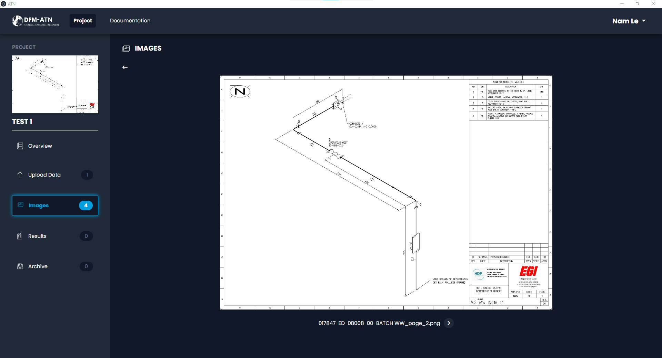
2. GUIDE D’UTILISATION
10
9
9. Click on each detected plan to view more in details.
10. Click on the arrow button to return to the previous page.
9
08/04/2024

Slide 10
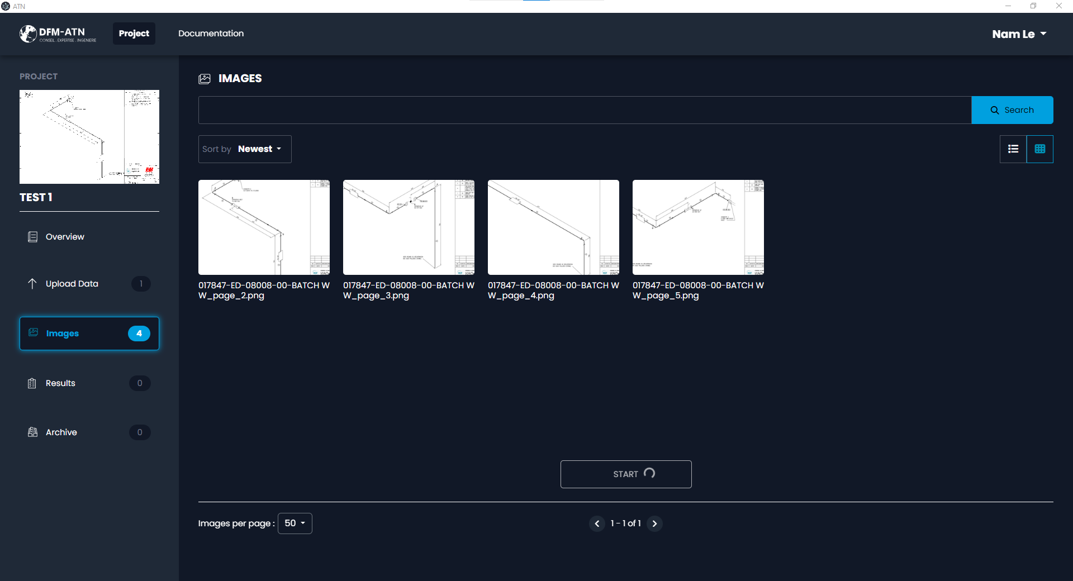
2. GUIDE D’UTILISATION
13
11
12
11. Click on the “Start” button to start the data processing.
12. Wait a few minutes until the process is completed.
13. Click on the “Results” tab to view the results.
10
08/04/2024

Slide 11
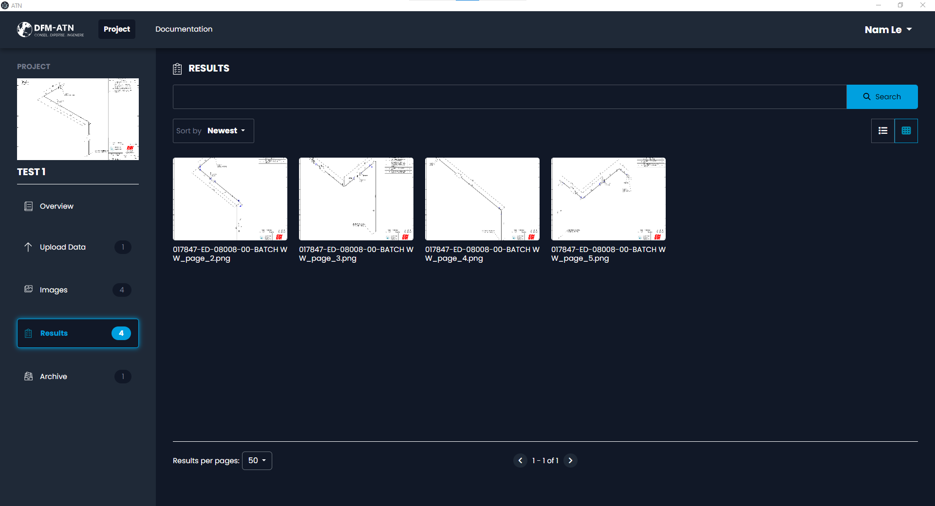
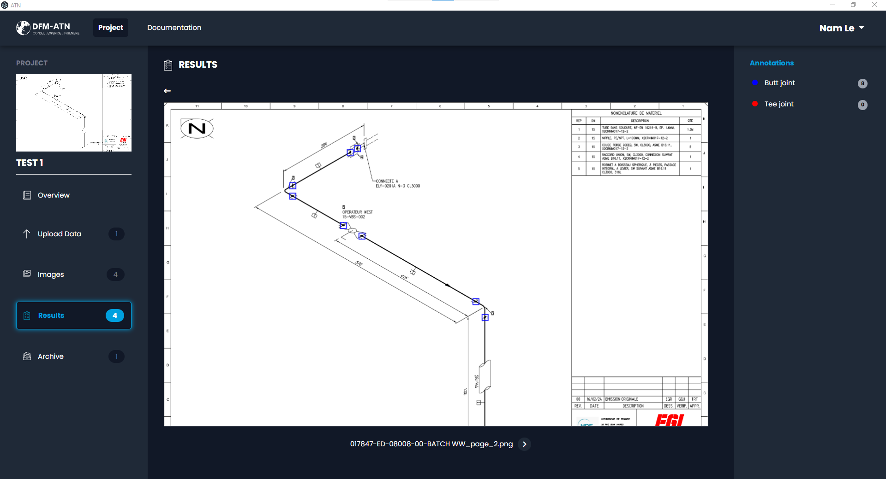
2. GUIDE D’UTILISATION
14
14. Click on each result to view more in details.
11
08/04/2024

Slide 12
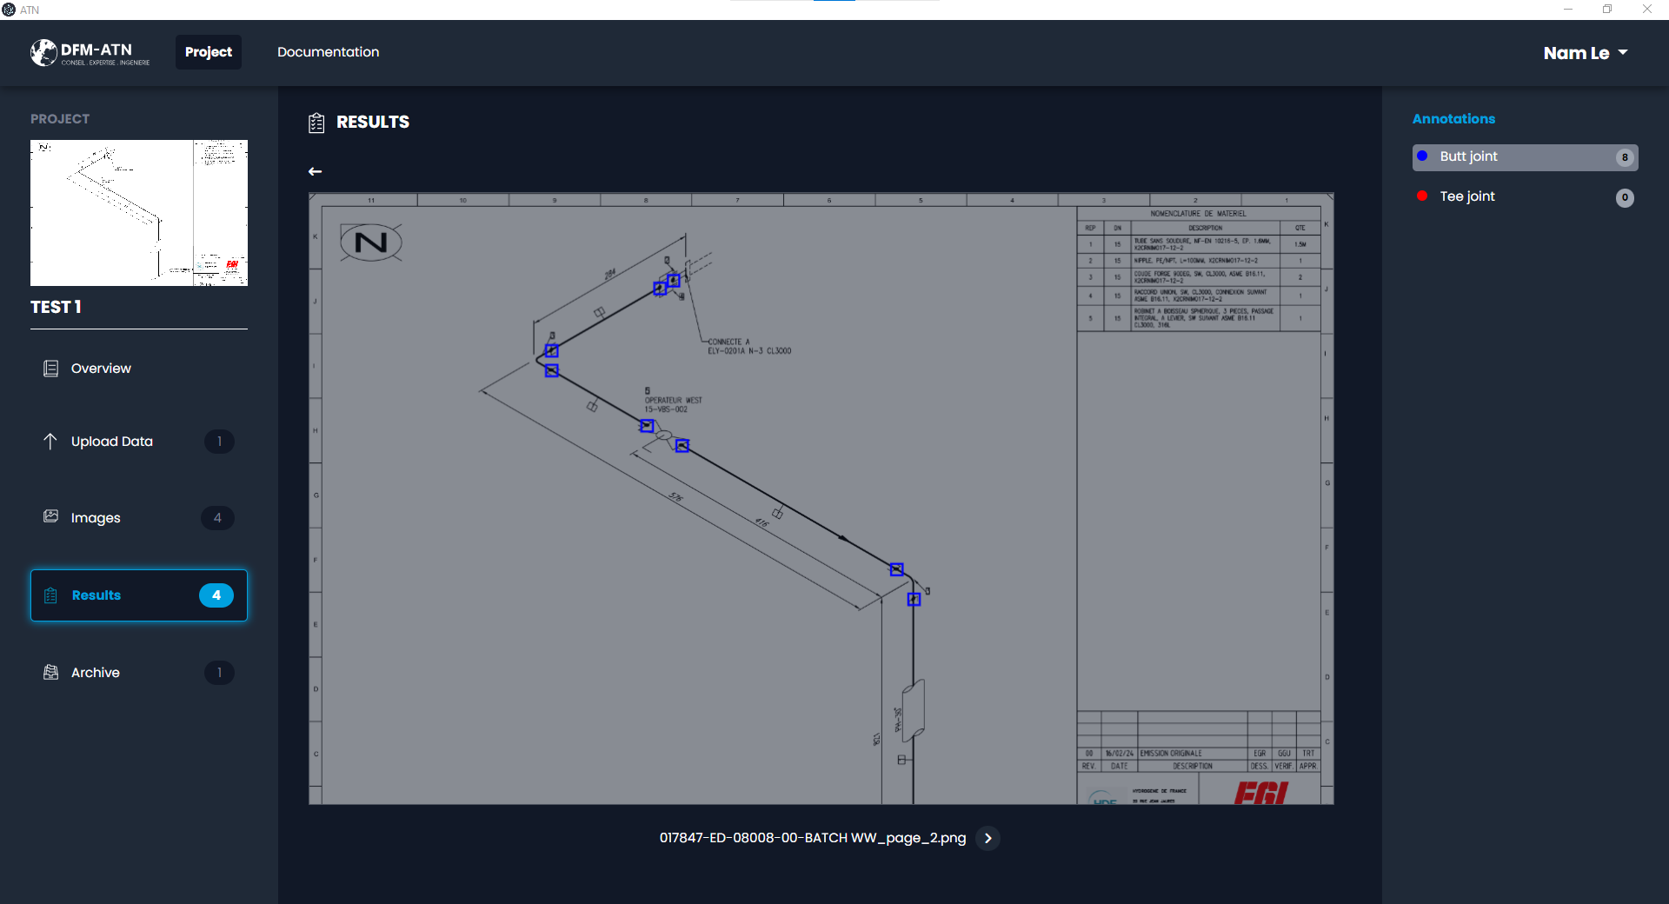
2. GUIDE D’UTILISATION
15
15. Click on the “Butt joint” to view the detected welds (type “soudure à suivre”).
12
08/04/2024

Slide 13
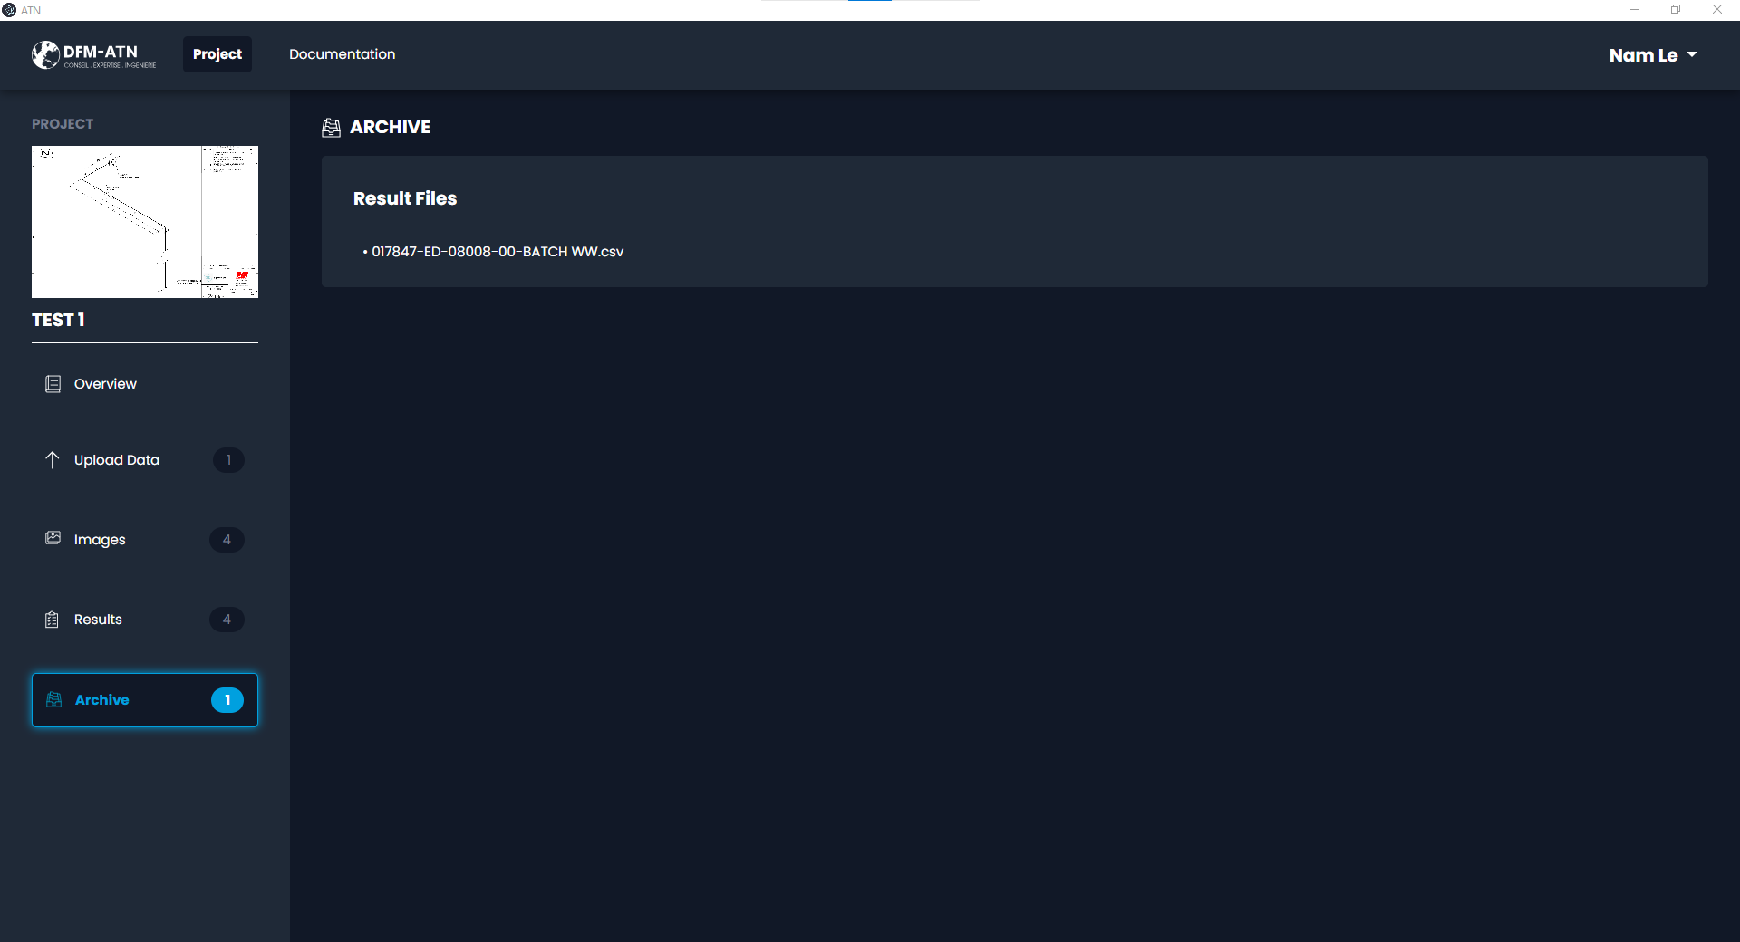
2. GUIDE D’UTILISATION
16
16. Click on the link to download the excel file.
13
08/04/2024

